Slide 1
Matrix Operations - Addition, Subtraction, Multiplication, and Type Checking PROGRAMMING FUNDAMENTALS
Calculate your given Matrix!

Slide 2
ABOUT PROGRAM & MATRIX
A set of numbers arranged in rows and columns so as to form a rectangular array, we are able to perform different operations on matrices:
ADDITION
MULTIPLICATION
SUBTRACTION!
And the most important thing we are able to check the type of result matrix in this program..

Slide 3
CONCEPT REQUIREMENTS
PF
ALGORITHMS
MATHS
Clear understanding of programming fundamentals is compulsory.
Algorithm is the most required thing to write this type of program.
Basic math and matrix concepts are required.

Slide 4
KEY CODE SEGMENTS
01
02
03
04
INPUT PHASE
OPERATIONS PHASE
User inputs dimensions and elements for two matrices (A and B).
Addition, Subtraction and Multiplication can be performed on user’s choice.
RESULT PHASE
Type Checking Phase
After performing the selected operation. Result matrix will be updated.
After updating the result matrix user will be Allowed to check the type of result matrix.

Slide 5
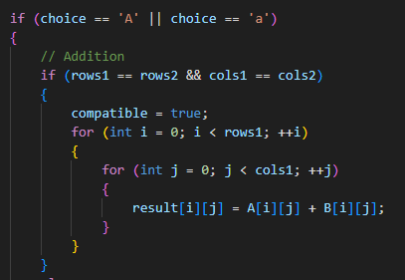
MAIN LOGICS

Slide 6
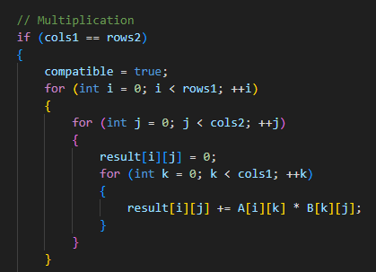
MAIN LOGICS

Slide 7
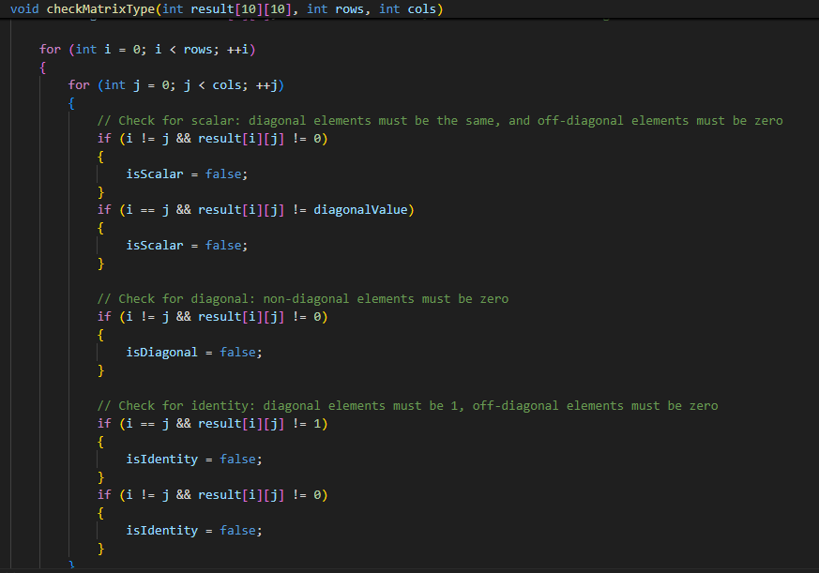
MAIN LOGICS

Slide 8
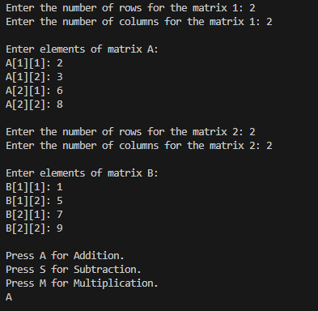
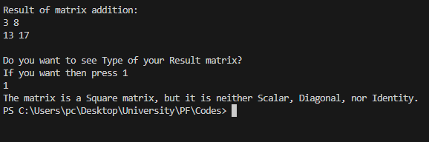
Sample Output

Slide 9
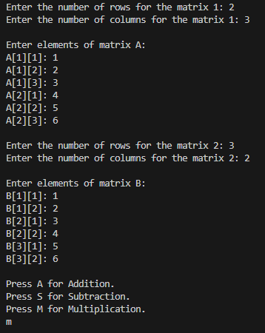
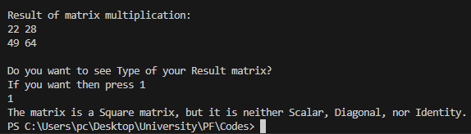
Sample Output

Slide 10
THANK YOU!

